Slide 1

Contract Tentative Agreement:
What changed?
AFSCME Local 517
Presentation

Slide 2

The Financials-No Changes
Contract valid for 3 years meaning less frequent negotiations.
Cost of living adjustments of 3.25% for 2026, 3% for 2027, and 2.75% for 2028.
Anniversary range movements of 4% for 2026, 3.5% for 2027, and 3.5% for 2028.
Bilingual pay memorandum of agreement raises from $50 biweekly to $75 biweekly.
Workers in years 1-5 will move to 21 PTO days from 20.

Slide 3
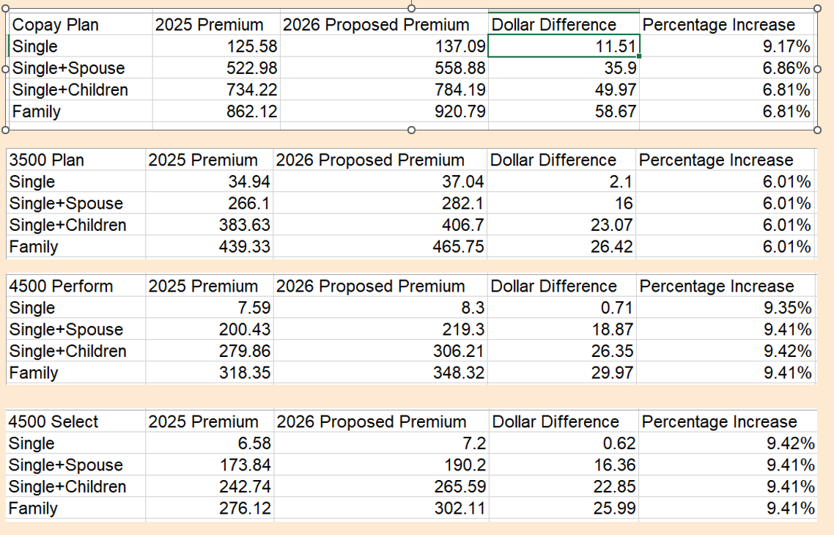
The Insurance- No Changes from last presentation

Slide 4
Other changes that carried over from the last mediation
A public emergency or weather events would require an employee to respond to such an event.
Medical documentation may be required after first 48 hours of ESST (earned sick/safe time).
Employees with less than 5 years of service go from 20 to 21 days. New accrual rate begins after the board signs the contract.
Minnesota Paid Leave premiums will be split 50/50 between employer/employee
Promotional probationary periods outside of the bargaining unit increase from 6 months to 12 months and employees retain their classification seniority rights for 12 months as well.
Unpaid leave hours shall extend the probationary period by the same number of hours utilized (including MPL and/or FMLA).

Slide 5
So what DID we get?
The county has agreed in an MOA to bring the short term disability late enrollment (with 12 month penalty) to a vote in the insurance labor management committee. The group seems receptive to the change so we anticipate this will move forward. For first 12 months, there’s a 6 week elimination period instead of 1 week for physical illness, mental illness, or birth of a child. No penalty on accident claims. After 1 year, the regular short term disability rules will apply.
The county has agreed in an MOA to shop an unembedded health plan with lower deductibles at the next renewal. We can’t implement during our current 3 year contract as it’s more than a 5% change which would cost us our rate cap and could potentially make the health insurance taxable.

Slide 6
Anything else?
The county has agreed to add in Weingarten rights to our contract which will preserve your right to representation during an investigation and/or discipline.
The county has agreed to give employees at least 14 days notice of a permanent principal work location change except in case of an emergency or when the employee and employer both agree to the change without appropriate notice. If the permanent work location is changed with less than 14 days notice, the employee will be reimbursed for any additional mileage incurred as a result of the change for the duration of the 14 day notification period.
The county will meet and confer with AFSCME to work on making mental health resources more accessible to employees.
The county will agree to put a focus on mental health, stress management, and other opportunities into its annual employee health fair.

Slide 7
Things that will help us connect with new employees
The county will put a link to the AFSCME Local 517 website on washnet.
The county will add exclusive representative information to the end of the agenda.
The sign in/registration for orientation document will list the employee’s bargaining unit.

Slide 8

What is the negotiation team’s recommendation here?
The negotiations team is recommending that the membership accept this tentative agreement.

Slide 9
There were no financial changes; why should we accept?
We have pushed as hard as we can and believe we have gotten everything that we can without striking. We don’t believe striking would result in a net benefit to the membership at this time.
We have gotten significant concessions with contract language that we believe protect our members.
The county previously refused to look into an unembedded health plan with lower deductibles. Getting an agreement to bring that to the ILMC is a very significant win as is making short term disability available to all without evidence of insurability.

Slide 10

What are the next steps?
We vote again. Voting will be held virtually on May 12th from 8am-4pm and in person at all 4 main sites from 11am-2pm on May 13th.
If the contract passes, it’s expected to be approved by the board at their June 2nd meeting and then work will begin in payroll for back pay/insurance reimbursements. If you leave employment prior to the board signing, you will not receive backpay/reimbursements
If the contract does not pass, we will be headed to a strike.

Slide 11

It has been our honor to fight on your behalf. The decision is in your hands now!

